Slide 1

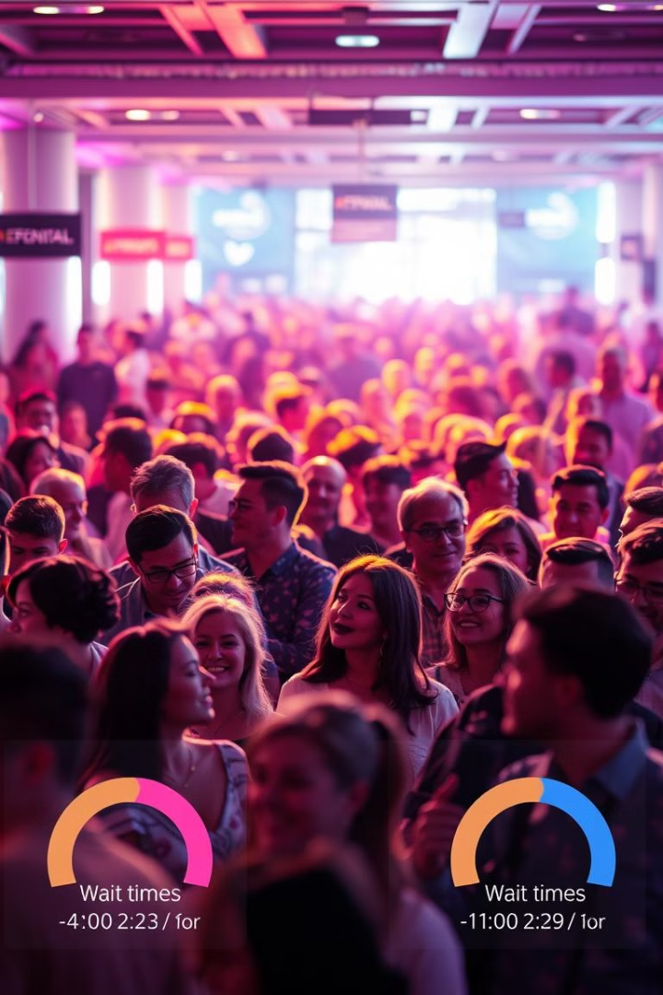
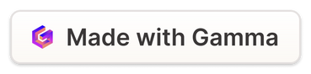
Crowd Detection and Wait-Time Prediction
The project explores a real-time crowd detection and wait-time prediction system. This system utilizes the YOLOv8 model for accurate crowd detection and wait-time estimation based on video inputs.
Notes:
1

Slide 2
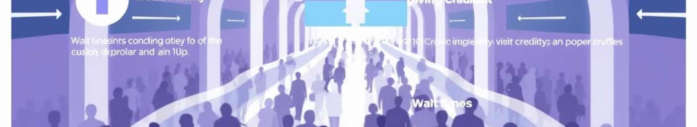
Problem Statement
Crowd density estimation and wait-time prediction are challenging problems, particularly in dynamic and crowded environments.
Real-time Processing
Accuracy
Scalability
The system needs to process video inputs in real-time, providing timely insights for proactive decision-making.
Accurate crowd detection and wait-time estimation are essential for effective crowd management.
The system must be scalable to handle high volumes of video data and adapt to varying crowd sizes and environments.
Notes:
3

Slide 3
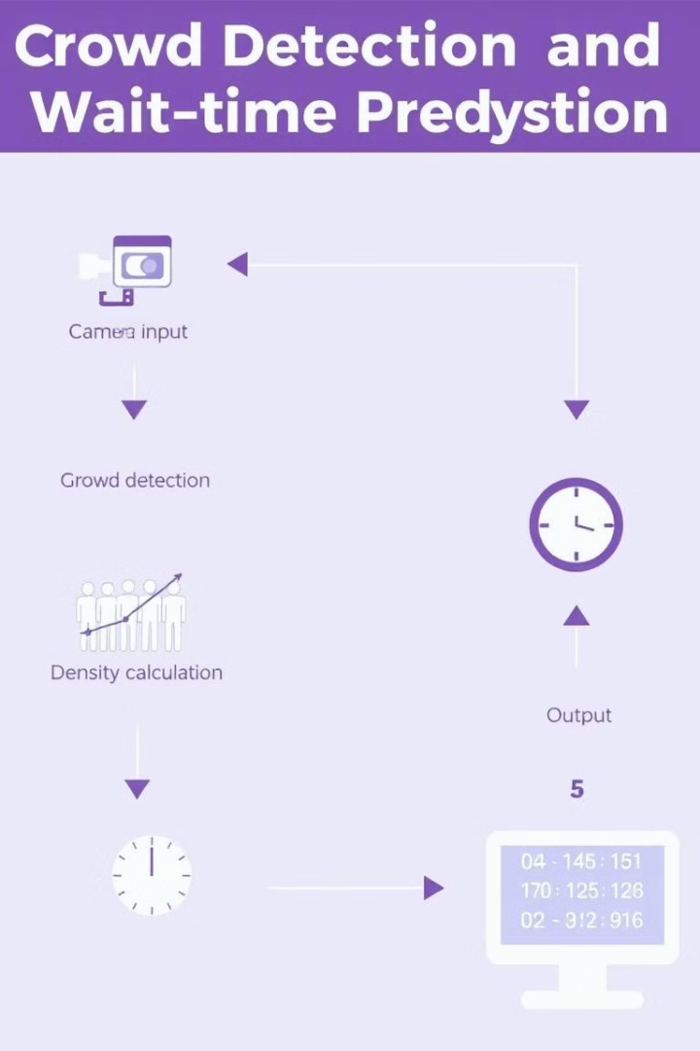
Proposed Solution
This project proposes a real-time crowd detection and wait-time prediction system based on the YOLOv8 model.
1
Crowd Detection
The YOLOv8 model identifies and counts individuals in video frames, providing real-time crowd density data.
2
Wait-Time Estimation
The system estimates the wait time at various locations based on crowd density, historical data, and queue movement patterns.
3
Visualization and Alerting
Real-time visualizations and alerts are generated to notify users about potential congestion and wait times.
Notes:
4

Slide 4
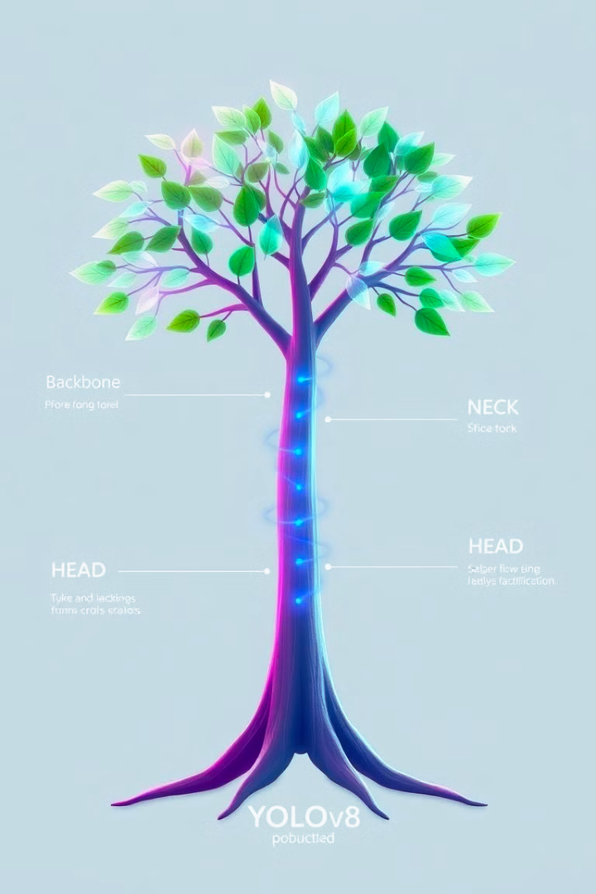
YOLOv8 Model Overview
YOLOv8 is a state-of-the-art object detection model known for its high accuracy and speed.
Accuracy
YOLOv8 delivers high accuracy in object detection, enabling precise crowd counting.
Speed
Its fast inference speeds allow for real-time processing of video data, enabling rapid crowd density updates.
Scalability
The model can be easily adapted to handle varying crowd sizes and environments, making it suitable for diverse applications.
Notes:
5

Slide 5
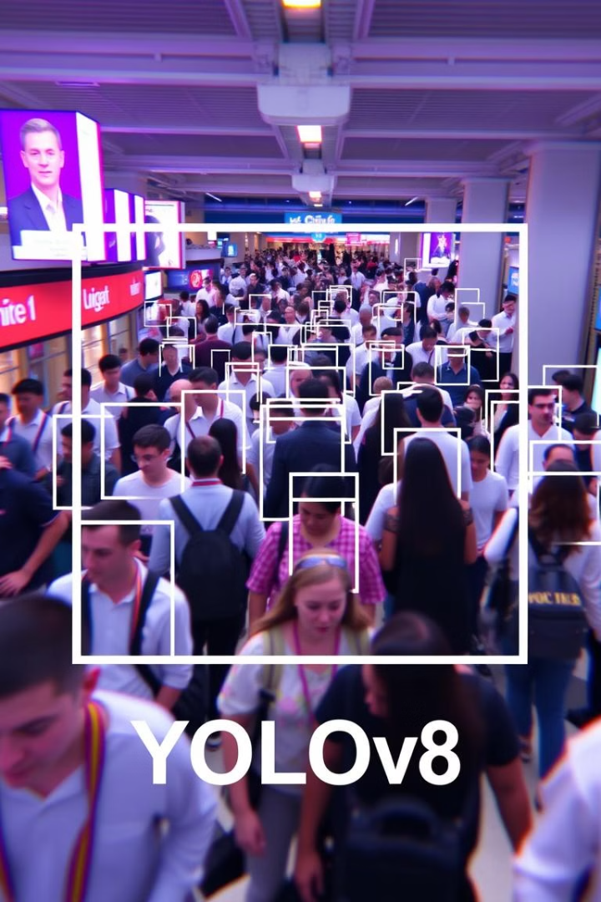




Video Processing and Crowd Counting
The system processes video input frames in real-time, utilizing YOLOv8 for object detection and crowd counting.
Input Video
The system receives live or recorded video input as its data source.
Frame Extraction
The video stream is divided into individual frames for processing.
YOLOv8 Detection
The YOLOv8 model analyzes each frame to identify and locate individuals within the scene.
Crowd Counting
The number of detected individuals in each frame is counted, providing real-time crowd density data.
Notes:
6

Slide 6
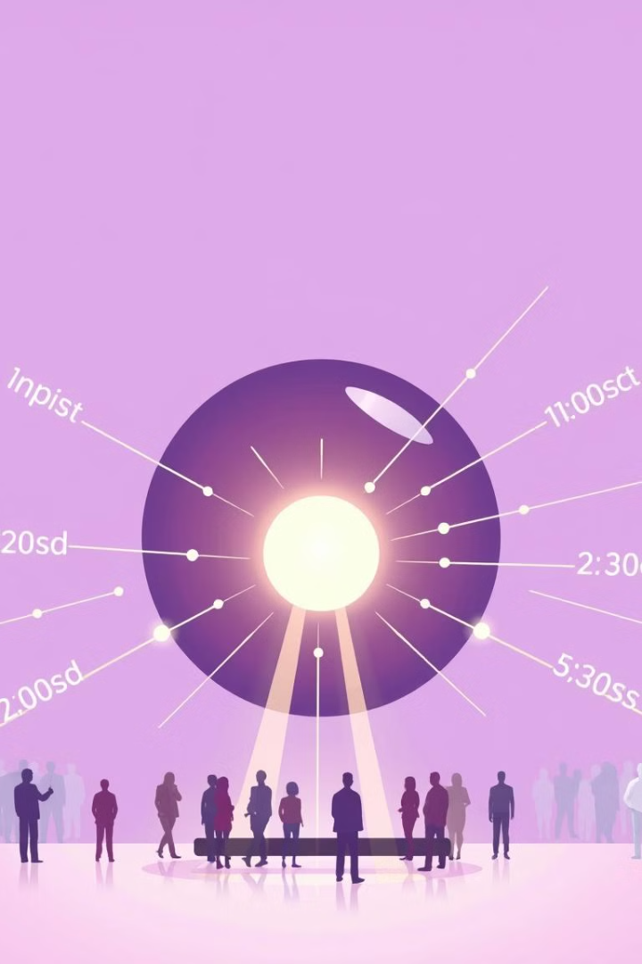



Wait-Time Prediction Algorithm
The wait-time prediction algorithm utilizes crowd density data, historical wait times, and queue movement patterns.
Crowd Density
Real-time crowd density data from YOLOv8 is used as a key input to the algorithm.
Historical Data
Past wait times at similar locations and time periods are considered to improve prediction accuracy.
Queue Movement
Analysis of queue movement patterns helps refine wait-time estimations based on the rate of queue progression.
Notes:
7

Slide 7
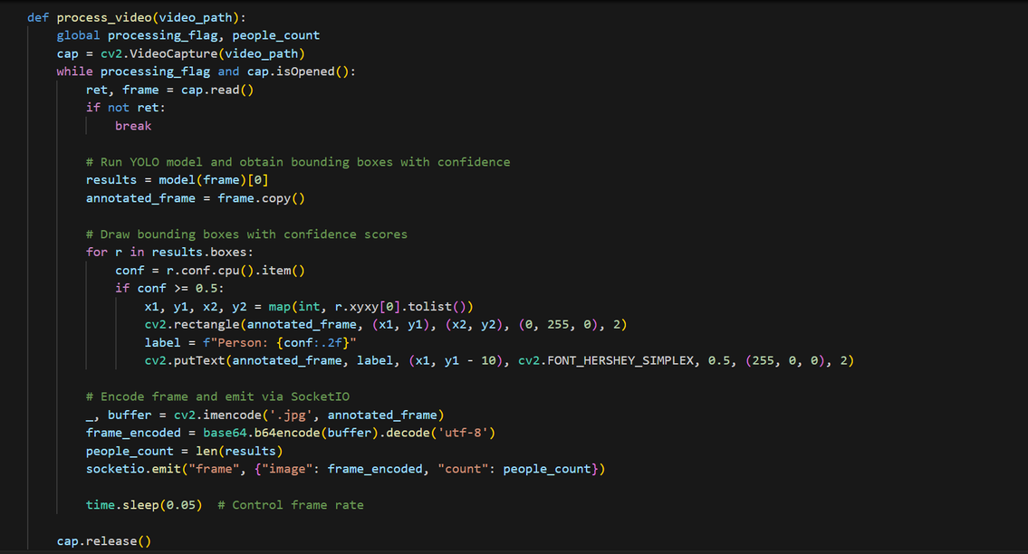
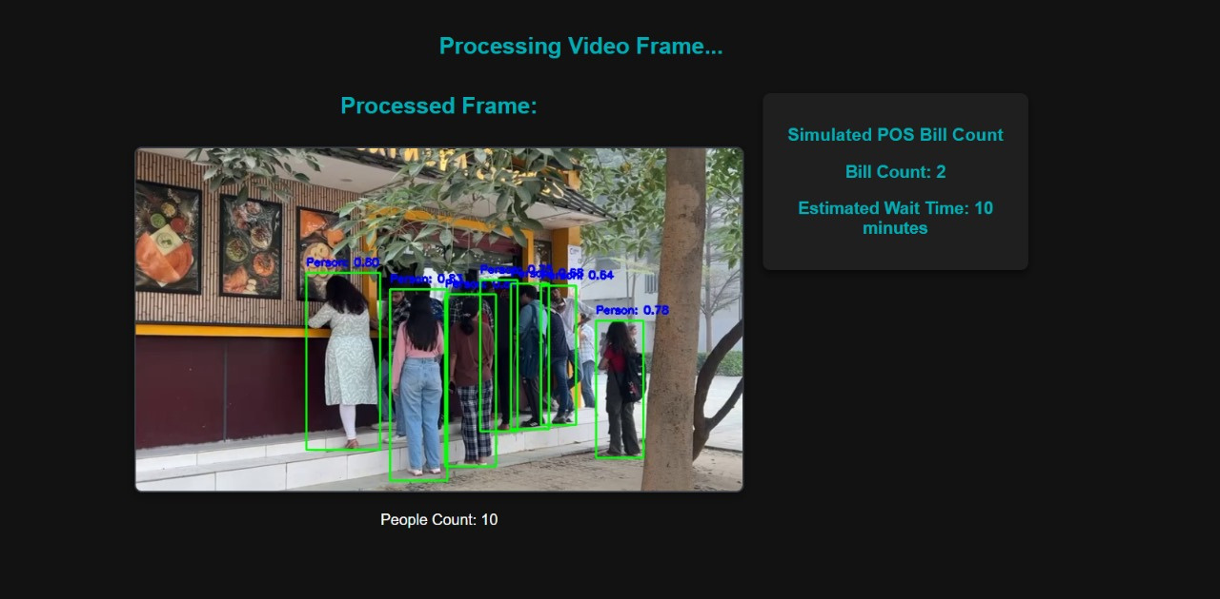
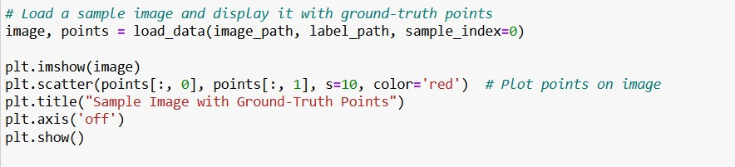
Code Snippets

Slide 8
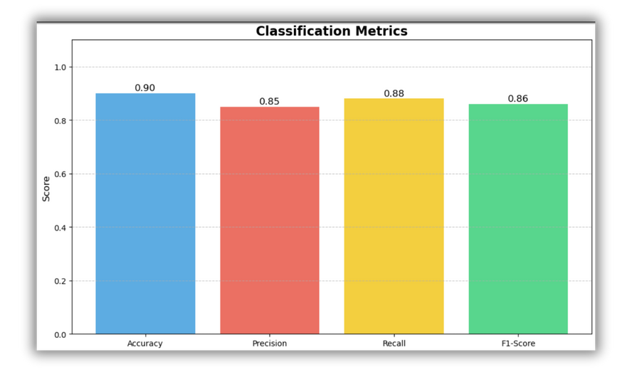
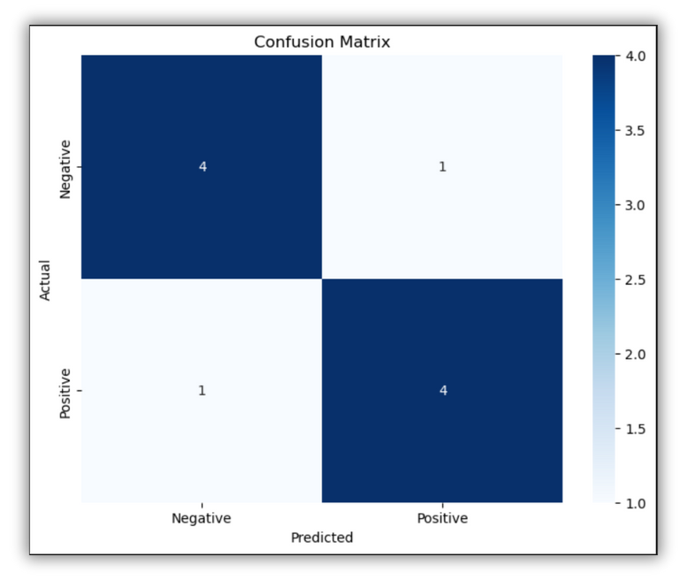
Results and Evaluation
The system has been evaluated on a diverse dataset of video recordings from various public spaces.
Accuracy
Real-time Performance
Using the YOLOv8 model, the system demonstrated an accuracy of *85-90%* for detecting and counting individuals in video feeds.
The system achieved a frame processing rate of around *20-30 frames per second* on a standard GPU, ensuring smooth real-time detection even in dynamic, high-density environments.
Processing Efficiency:
The system successfully processed pre-recorded video feeds without significant delays, showcasing its capability for real-time applications in environments like college food outlets.
Notes:
8

Slide 9

Conclusion and Future Work
The project demonstrates an effective system for crowd detection and wait-time prediction, using YOLOv8 for live crowd detection. By automating crowd management and wait-time estimation, it offers a valuable tool for busy college food outlets.
Integration with other systems
Improving prediction accuracy
Advanced AI for Behavior Analysis
Notes:
9

Slide 10
THANK YOU
ARYANSHH SRIVASTAVA
NISHTHA MAHESHWARI

